Slide 1
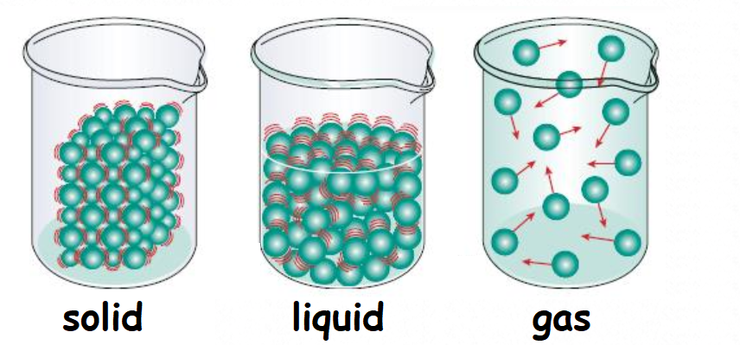
Date:_______
Particle Theory of Matter
An Introduction to Chemistry

Slide 2
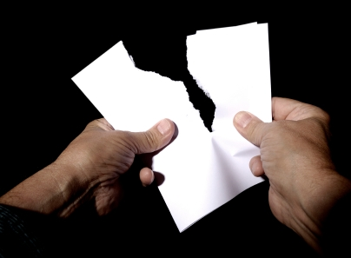
Minds On
Rip a piece of paper in half
Keep ripping it into smaller
and smaller pieces
Can you keep on ripping it forever?
  The ancient Philosophers
  thought about this simple question
  for all the different types
  of matter (stuff) on Earth.

Slide 3
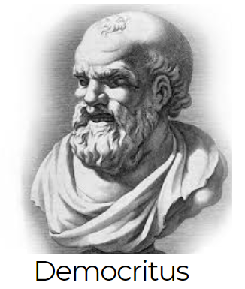
What Is Matter?
The Ancient Philosophers knew…
  Matter has ______
  Matter takes up _______
They used logic to hypothesize that…
  All matter is made up of microscopic ________
  Each pure substance has its own _________
  type of particle
  If you split these smallest particles then you would end up with something ________

Slide 4
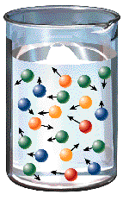
Today We Know:
The Ancient Philosophers were _________!
  All matter is made up of microscopic particles
  Each pure substance has its own
  unique type of particle
We also know that:
  3. The particles are always ________
  4. Particles move ________in a solid.
  (e.g. Ice)
  5. Particles move more ________in a
  liquid or gas. (e.g. Water or steam)
Temperature is a measure of how fast particles are moving!

Slide 5
The Particle Theory of Matter
All matter is made of extremely ______ particles
All pure substances are made of their own _______ of particle
All particles are _______________.
Particles at higher temperatures move _________ than those at lower temperatures.
Particles are ___________ to each other.

Slide 6
Three States of Matter
For normal conditions, there are three states:
  Solid – Particles are ______ together
  Liquid – Particles are ________ apart
  Gas – Particles are _______ far apart
The particles are the same in each state!
  They just have a different ___________
  And they are moving ___________

Slide 7
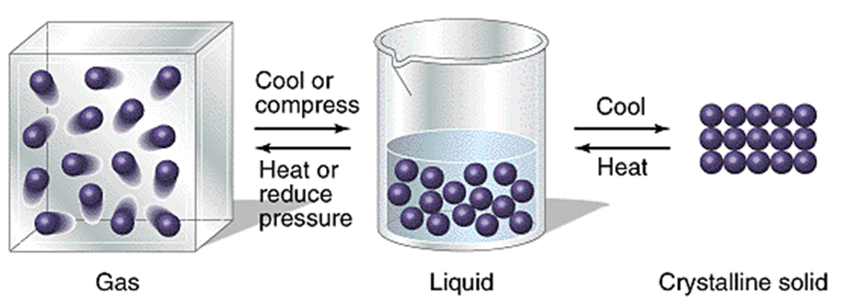
Water
Particles are moving slowly.
Particles are ________ spaced and strongly attracted
Ice
Water particles are moving very slowly
Particles are _______ in place and are very strongly attracted
Water Vapour
Particles are moving ______
Particles are _______ apart and weakly attracted

Slide 8
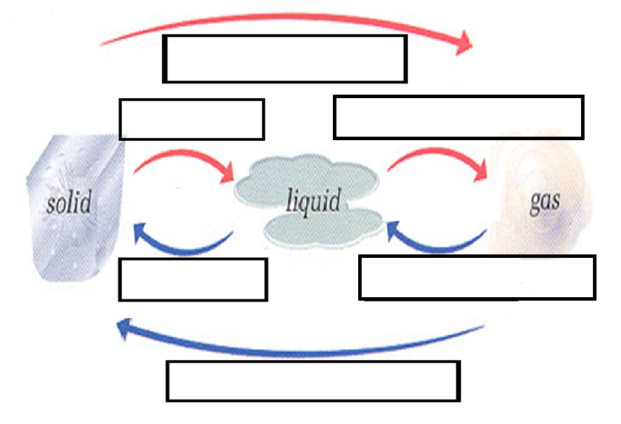
Changes of State

